Slide 1
Preliminary design Review
R2D2
Rapid Rocket Delivery Device

Slide 2
Presentation Overview
Introduction
Requirements
Aerodynamics
Propulsion
Structure
Control
Schedule
Introduction
Requirements
Aerodynamics
Propulsion
Structure
Control
Schedule

Slide 3
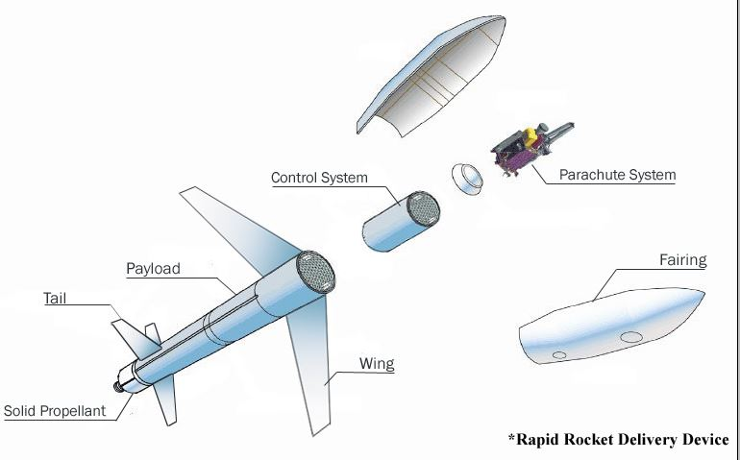
R2D2 Concepts
Introduction
Requirements
Aerodynamics
Propulsion
Structure
Control
Schedule
Number 2 (Rocket + Glider + Parachute System)
R2D2
Rapid
Rocket
Delivery
Device

Slide 4
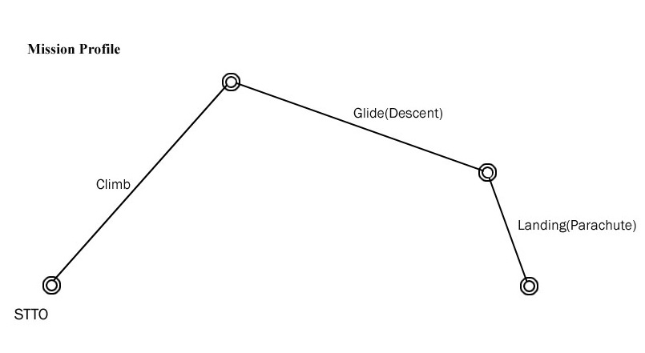
Mission Profile
Introduction
Requirements
Aerodynamics
Propulsion
Structure
Control
Schedule

Slide 5
Requirements
Introduction
Propulsion
Structure
Control
Schedule
Aerodynamics
Requirements
Payload (kg) | Total Weight (kg) | Cruise Speed (m/s)
23.3 | 50 | 64.0
Duration Of Flight (min) | Range (km) | Altitude (km) | Control | Rate of Sink (m/s) | Landing Error (m)
7 | 25 | 2.476 | Automatic Control System Using GPS | 2.72 | 50

Slide 6
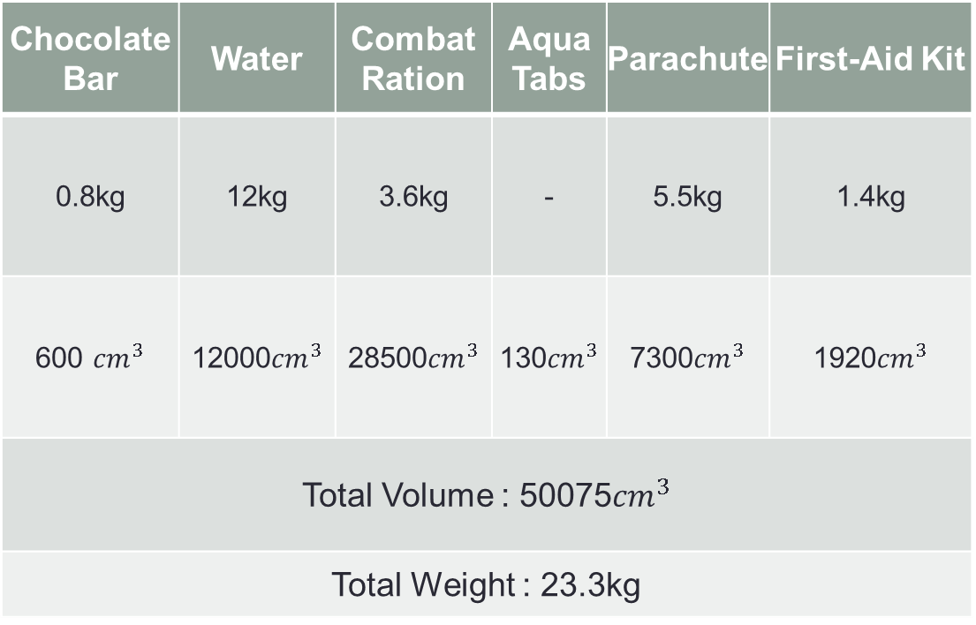
Weight & Volume
Introduction
Propulsion
Structure
Control
Schedule
Aerodynamics
Requirements
Chocolate Bar | Water | Combat Ration | Aqua Tabs | Parachute | First-Aid Kit
0.8kg | 12kg | 3.6kg | - | 5.5kg | 1.4kg
600 ${cm}^{3}$ | 12000${cm}^{3}$ | 28500${cm}^{3}$ | 130${cm}^{3}$ | 7300${cm}^{3}$ | 1920${cm}^{3}$
Total Volume : 50075${cm}^{3}$
Total Weight : 23.3kg

Slide 7
Lift curve
Introduction
Aerodynamics
Propulsion
Structure
Control
Schedule
Requirements
Stall angle of attack : 20°
Zero angle of attack : -0.75°

Slide 8
Drag polar
Introduction
Aerodynamics
Propulsion
Structure
Control
Schedule
Requirements

Slide 9
Longitudinal stability
Introduction
Aerodynamics
Propulsion
Structure
Control
Schedule
Requirements

Slide 10
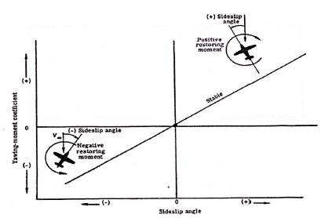
Directional stability
Introduction
Aerodynamics
Propulsion
Structure
Control
Schedule
Requirements

Slide 11
Lateral stability
Introduction
Aerodynamics
Propulsion
Structure
Control
Schedule
Requirements
받음각 (degree)
-4 | -1.68E-05
-2 | -2.34E-04
0 | -4.40E-04
2 | -6.53E-04
4 | -8.78E-04
6 | -1.11E-03
8 | -1.35E-03
10 | -1.60E-03
12 | -1.83E-03
14 | -2.00E-03
15 | -2.07E-03
16 | -2.13E-03
17 | -2.17E-03
18 | -2.19E-03
20 | -2.18E-03

Slide 12
Simple datcom design
Introduction
Aerodynamics
Propulsion
Structure
Control
Schedule
Requirements

Slide 13
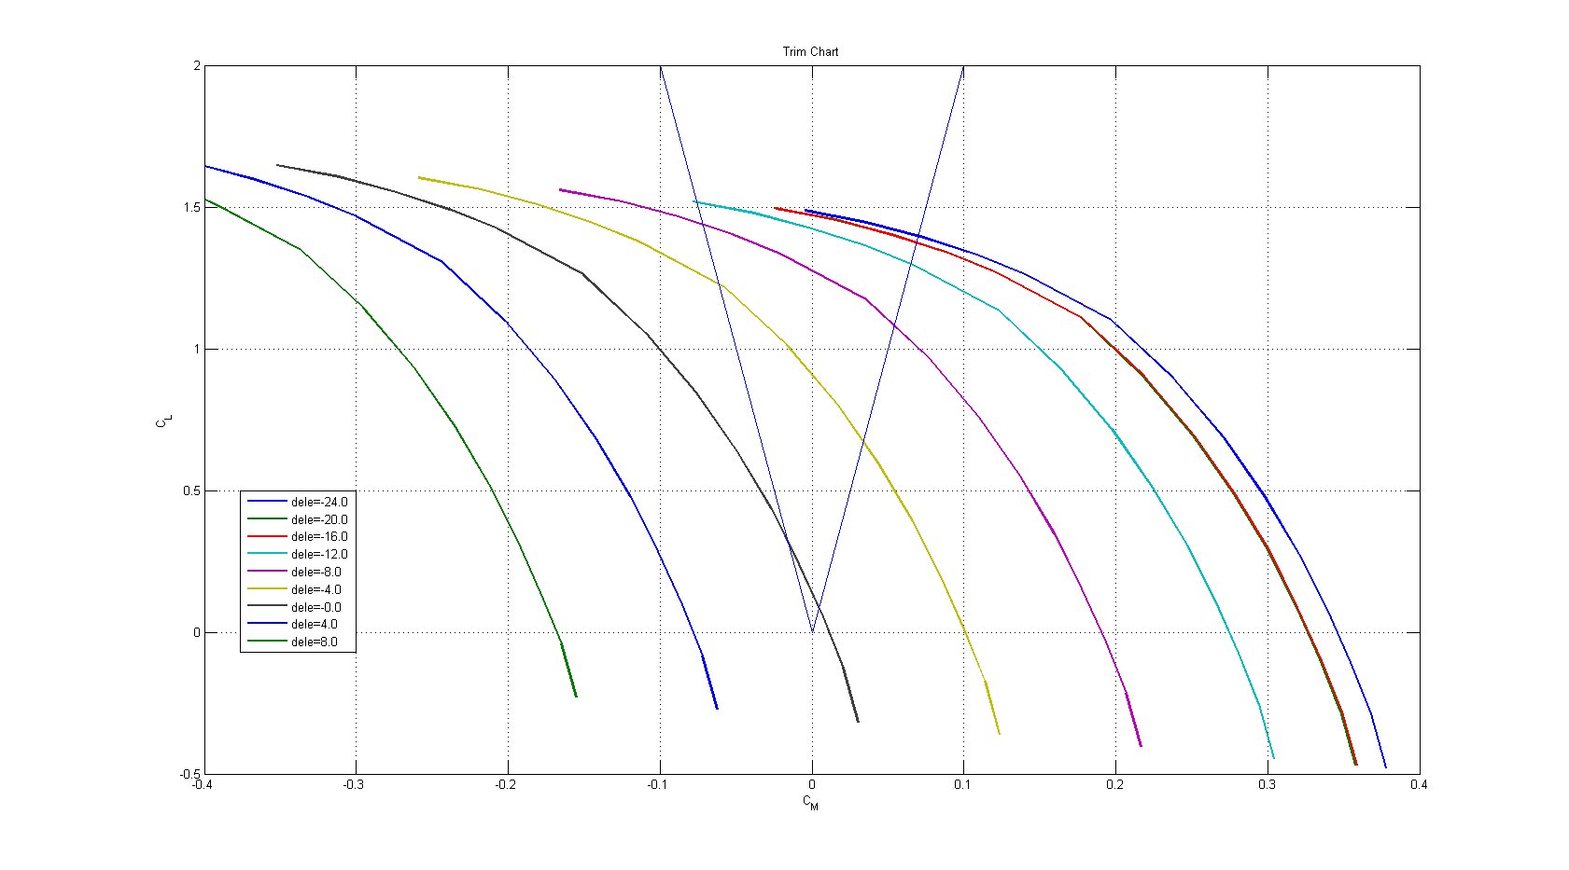
Trim chart
Introduction
Aerodynamics
Propulsion
Structure
Control
Schedule
Requirements

Slide 14
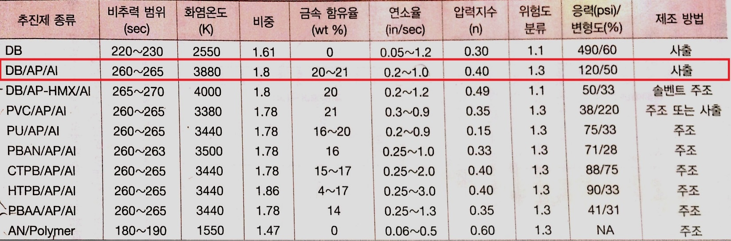
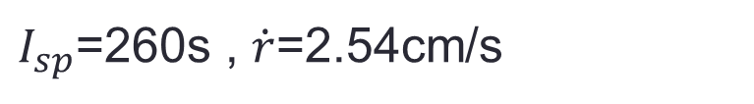
Thrust and altitude
Introduction
Propulsion
Control
Schedule
Requirements
Aerodynamics
Structure
1. Select propellant
$I_{sp}$=260s , $\dot{r}$=2.54cm/s

Slide 15



Thrust and altitude
Introduction
Propulsion
Control
Schedule
Requirements
Aerodynamics
Structure
2. Effective exhaust velocity and altitude
$u_{eq}$=2511m/s

Slide 16
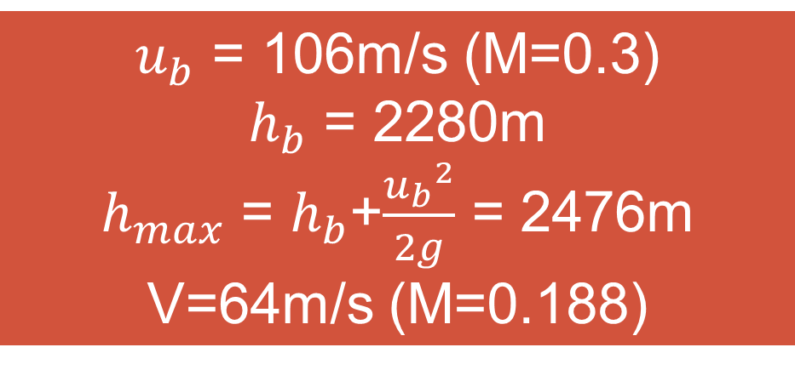
Thrust and altitude
Introduction
Propulsion
Control
Schedule
Requirements
Aerodynamics
Structure
2. Effective exhaust velocity and altitude
$u_{b}$ = 106m/s (M=0.3)
$h_{b}$ = 2280m
$h_{max}$ = $h_{b}$+$\frac{{u_{b}}^{2}}{2g}$ = 2476m
V=64m/s (M=0.188)

Slide 17


Thrust and altitude
Introduction
Propulsion
Control
Schedule
Requirements
Aerodynamics
Structure
2. Thrust
$∴\dot{m}$ = 0.8333kg/s
F = $\dot{m}u_{eq}$ = 2127N

Slide 18


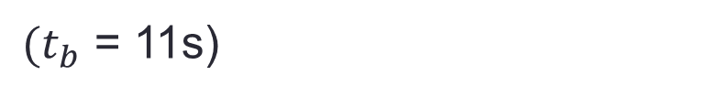
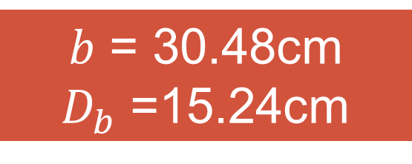

Grain shape
Introduction
Propulsion
Control
Schedule
Requirements
Aerodynamics
Structure
Grain volume, web thickness, cross-sectional area
$(t_{b}$ = 11s)
$m_{p}$ = 10kg
$V_{p}$ = $0.0056m^{3}$
$b$ = 30.48cm
$D_{b}$ =15.24cm

Slide 19
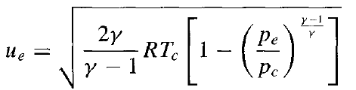
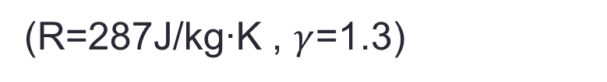

Nozzle Design
Introduction
Propulsion
Control
Schedule
Requirements
Aerodynamics
Structure
1. Combustion chamber pressure
(R=287J/kg∙K , $γ$=1.3)
$P_{c}=$10022165N/$m^{2}$

Slide 20
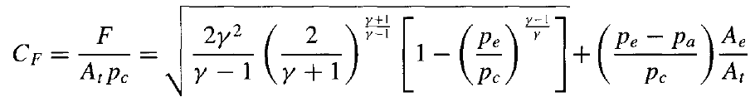
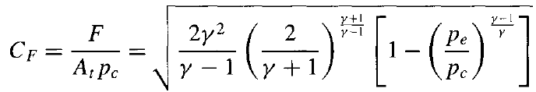

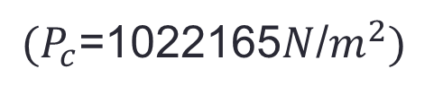
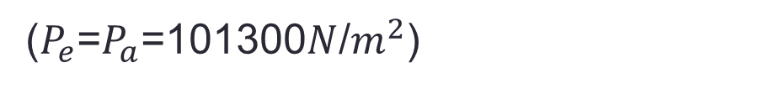
Nozzle Design
Introduction
Propulsion
Control
Schedule
Requirements
Aerodynamics
Structure
2. Thrust coefficient
($P_{e}$=$P_{a}$=101300$N$/$m^{2}$)
$C_{F}$=1.588145487
$(P_{c}$=1022165$N$/$m^{2})$

Slide 21


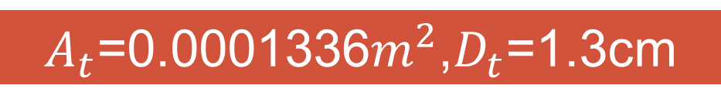
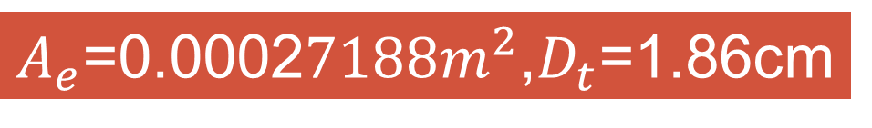
Nozzle Design
Introduction
Propulsion
Control
Schedule
Requirements
Aerodynamics
Structure
3. Nozzle area, Diameter
$A_{t}$=0.0001336$m^{2}$,$D_{t}$=1.3cm
$A_{e}$=0.0002$7188m^{2}$,$D_{t}$=1.86cm

Slide 22
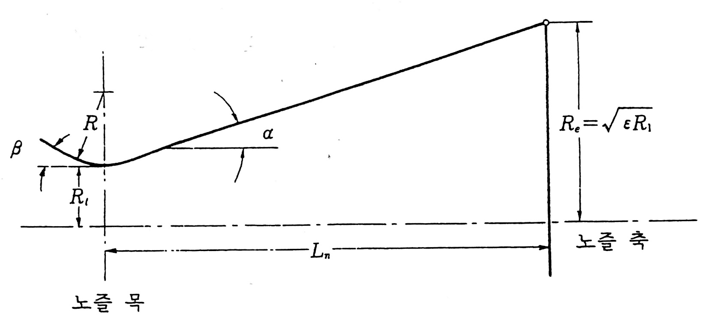
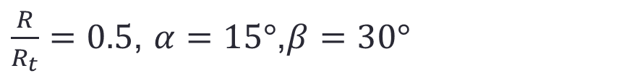

Nozzle Design
Introduction
Propulsion
Control
Schedule
Requirements
Aerodynamics
Structure
3. Nozzle curvature, length
$R_{t}$ = 0.65cm
$R$= $0.33$cm
$\frac{R}{R_{t}}=0.5$, $α=15°$,$β=30°$

Slide 23


Nozzle Design
Introduction
Propulsion
Control
Schedule
Requirements
Aerodynamics
Structure
3. Nozzle curvature, length
$L_{n}$ = 2.48cm

Slide 24
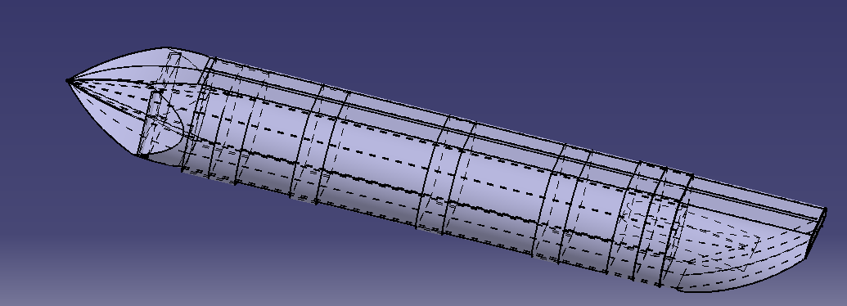
Structure
Introduction
Structure
Control
Schedule
Requirements
Aerodynamics
Propulsion
Fuselage
Body area = 561.06${cm}^{2}$
Length = 130cm
Total volume = 62184.15${cm}^{3}$
Spare volume = 12109${cm}^{3}$

Slide 25
Structure
Introduction
Structure
Control
Schedule
Requirements
Aerodynamics
Propulsion
Inner Fuselage structure.
 | Truss | Monocoque | Semi Monocoque
Variability | LOW | High | High
Durability | High | Medium | High
Weight | High | Medium | High
Utilization of Space | Low | High | Medium
Complexity | Medium | Low | High

Slide 26
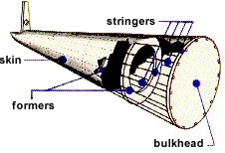
Structure
Introduction
Structure
Control
Schedule
Requirements
Aerodynamics
Propulsion
Illustration of Semi Monocuque Structure.
Skin : Outer surfaces of aircraft
Stringger : Bones of lateral direction
Formers : Form as body’s section,
Bones of longitudinal direction
Bulkhead (partition) wall within the hull of a ship,
vehicle, or container

Slide 27
Structure
Introduction
Structure
Control
Schedule
Requirements
Aerodynamics
Propulsion
Wing
Basic wing design
The lift distribution
Total Lift applied on one side wing = 250N.
so we determine the A=0.4244.

Slide 28
Structure
Introduction
Structure
Control
Schedule
Requirements
Aerodynamics
Propulsion
Wing
Basic wing design
Section (mm) | Concentrated Load (N) | Distance (mm) | Bending Moment (N·mm)
0 ~ 150 | 63.233 | 150 | 9483.95
150 ~ 300 | 60.6 | 300 | 18180
300 ~ 450 | 54.97 | 450 | 24736.5
450 ~ 600 | 45.17 | 600 | 27102
600 ~ 750 | 26.02 | 700 | 19965

Slide 29
Structure
Introduction
Structure
Control
Schedule
Requirements
Aerodynamics
Propulsion
Wing
Basic wing design
Maximum magnitude of the moment 27102 N·mm.
Simple model assume the spar’s cross section shape 10mm x 100mm.
we can get a stress by maximum bending moment,

Slide 30
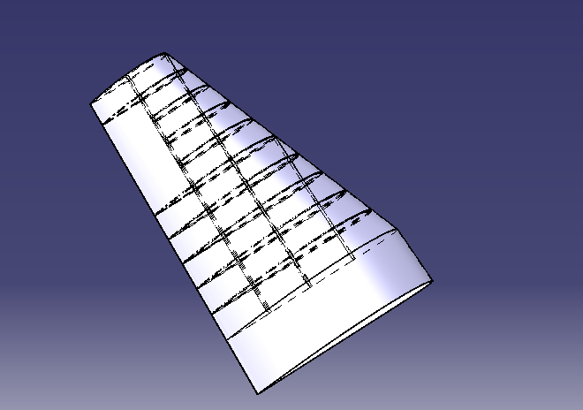
Structure
Introduction
Structure
Control
Schedule
Requirements
Aerodynamics
Propulsion
Wing
Initial wing model
3 Spars and 5 Ribs

Slide 31
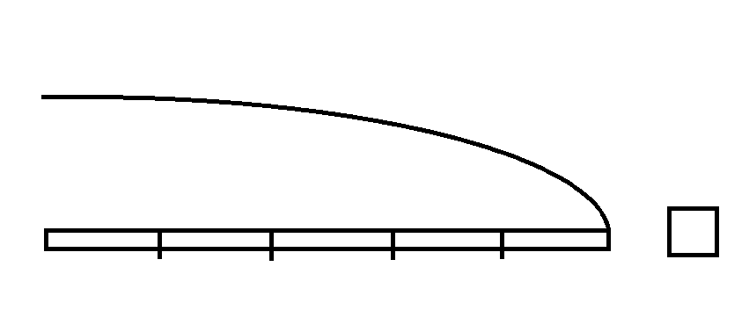
Basic wing analysis
Introduction
Structure
Control
Schedule
Requirements
Aerodynamics
Propulsion
Assumption
Static state
The magnitude of total lift is 250N
The spar is divided by five ribs
The cross section’s shape is square
The concentrated force is applied on ribs
Use the aluminium7075(yield stress is 434Mpa)

Slide 32
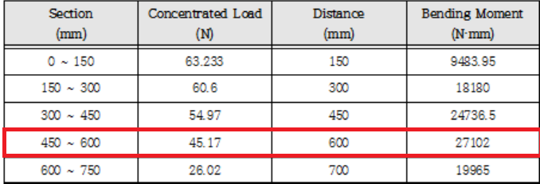

Basic wing analysis
Introduction
Structure
Control
Schedule
Requirements
Aerodynamics
Propulsion
It’s okay!

Slide 33
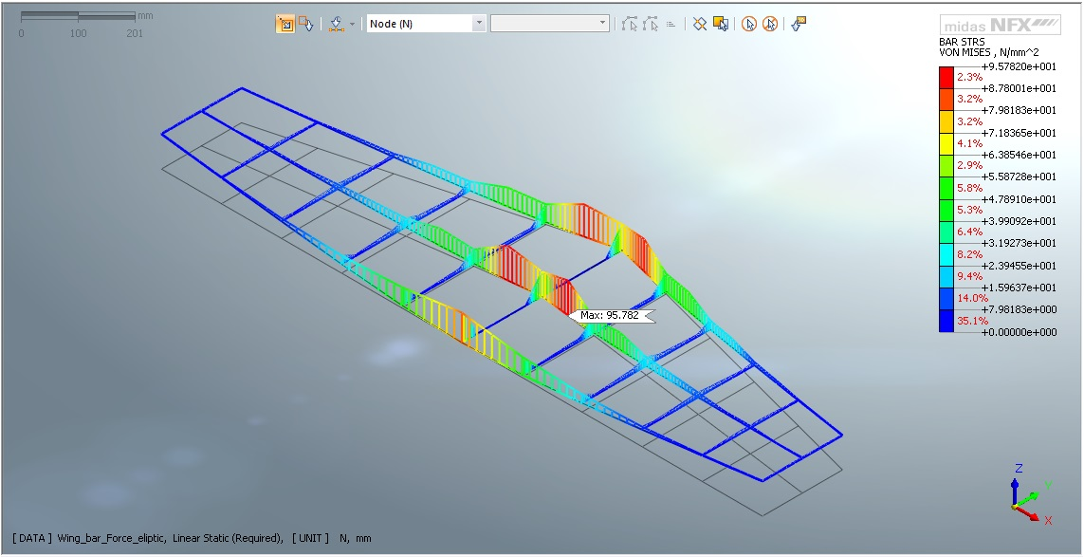
Basic wing analysis
Introduction
Structure
Control
Schedule
Requirements
Aerodynamics
Propulsion
It’s also okay!

Slide 34
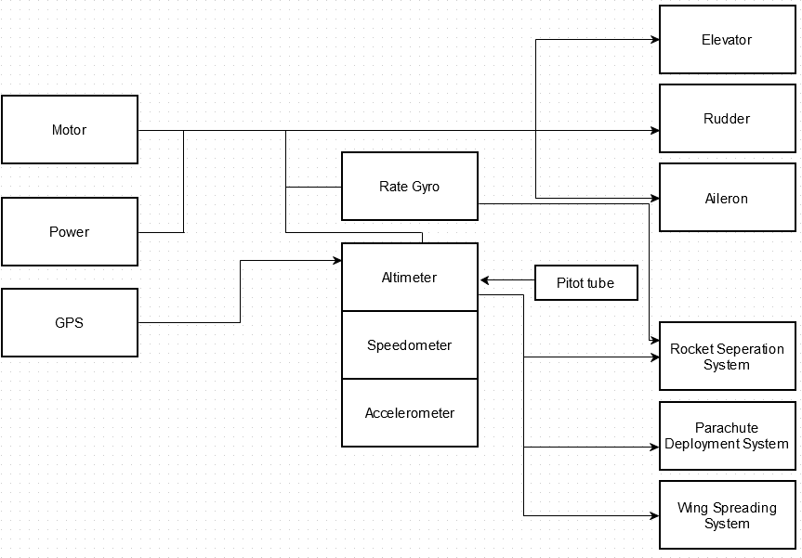
Control System
Introduction
Control
Schedule
Requirements
Aerodynamics
Propulsion
Structure
Similar Control System : I-AFCS
Including Rate gyro, Accelerometer, Altimeter, Speedometer

Slide 35
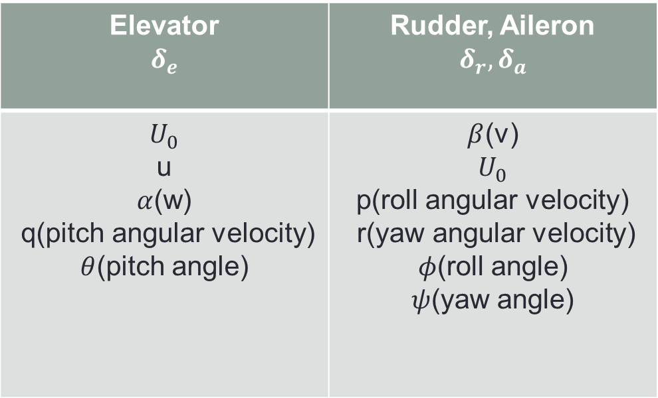
Control System
Introduction
Control
Q&A
Requirements
Aerodynamics
Propulsion
Structure
Rocket seperation control
- Using altimeter
Gliding needs position control
- Control for Elevator, Rudder, Aileron
Elevator $$δ_{e}$$ | Rudder, Aileron $$δ_{r}{,δ}_{a}$$
$$U_{0}$$ u $α$(w) q(pitch angular velocity) $θ$(pitch angle) | $β$(v) $$U_{0}$$ p(roll angular velocity) r(yaw angular velocity) $φ$(roll angle) $ψ$(yaw angle)

Slide 36
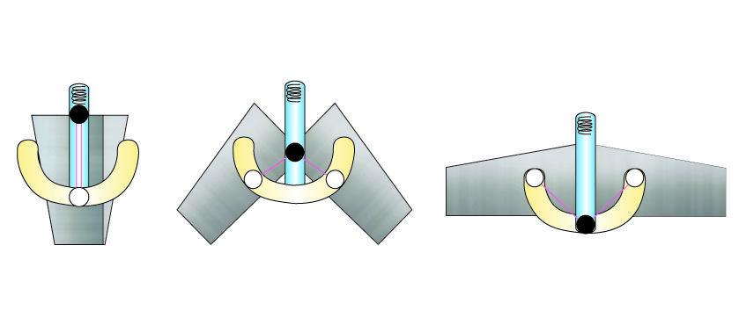
Wing Spreading Control
Introduction
Control
Schedule
Requirements
Aerodynamics
Propulsion
Structure
Control system with spring&rail
Wing spreading time is same with rocket seperation

Slide 37
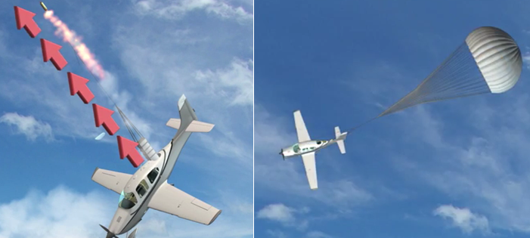
Parachute deploy system
Introduction
Control
Schedule
Requirements
Aerodynamics
Propulsion
Structure
Current system :
Concentrated on emergency situation
-> Need to develop creative system

Slide 38
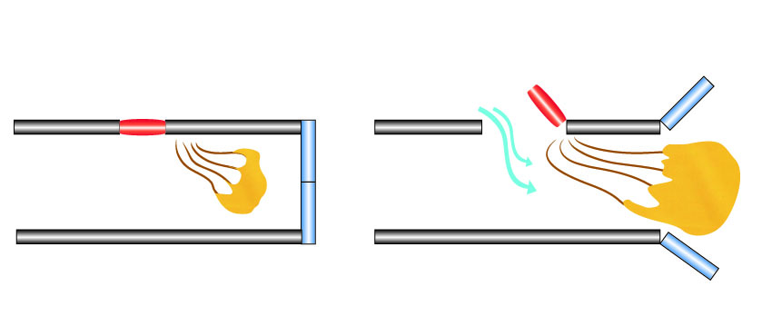
Parachute deploy system
Introduction
Control
Schedule
Requirements
Aerodynamics
Propulsion
Structure
R2D2’s parachute deploy system
Cover&back opens -> Wind blows -> Parachute deployment from direction of wind

Slide 39
Schedule
Introduction
Schedule
Control
Requirements
Aerodynamics
Structure
Propulsion
Week | Task
12, 13 | Subsystem Design Materials, Control System
14, 15 | Aerodynamic Analysis Propulsion Analysis
16, 17 | Structure Analysis Control System Analysis
18, 19 | Critical Design Review (6/30) Cost Estimation Mission Simulation

Slide 40

Introduction
Requirements
Aerodynamics
Propulsion
Structure
Schedule
Control

